Slide 1

Smart Academic Performance Monitoring System
Enhancing Student Performance Through Data-Driven Insights
Uganda’s Vision 2040 promotes digital innovation in education, yet many institutions still use outdated manual methods to track student performance, resulting in delays, errors, and poor communication. Current systems lack real-time monitoring and data analytics, leading to issues like falsified records and grading inaccuracies. The Smart Academic Monitoring System (SAMS) addresses these challenges by providing an integrated, automated platform for real-time performance tracking, attendance monitoring, and timely reporting—enhancing accuracy, accountability, and supporting SDG 4: Quality Education.
By ABSOLOM ORIANGA

Slide 2
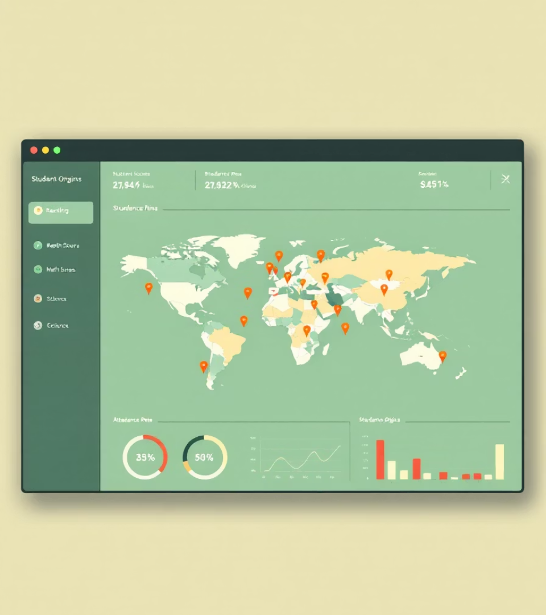





System Benefits
Improved Performance Monitoring
Automated tracking ensures timely feedback for students.
Enhanced Attendance
Biometric/RFID systems eliminate fraudulent attendance.
Real-time Alerts
Automated alerts for absenteeism and poor performance.
Data-Driven Decisions
Informed academic interventions.
Increased Parent Engagement
1.Parents can access their children’s academic reports and receive notifications on performance trends.

Slide 3

Database Tables
Users
Students
Stores user roles and credentials.
Tracks student enrollment and class details.
Teachers
Grades
Records teacher profiles and subject assignments.
Records scores and exam dates.
Admins
Parents
• contains admin-specific data, including role descriptions and linked user accounts.
stores parent details, contact information and link to user accounts.
Alerts
Subjects
•stores automated notifications for issues like low performance or absenteeism with timestamps
•lists subjects offered, each linked to the responsible teacher.
Attendance
Reports
•contains performance summaries generated by admins.

Slide 4

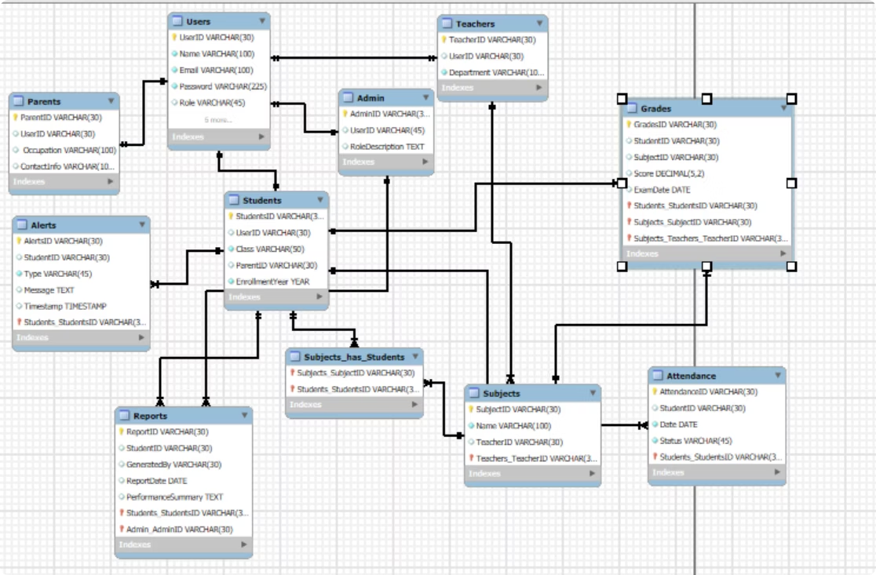
Entity Relationship Diagram
The ER Diagram illustrates the relationships between key entities within the SAMS database.

Slide 5
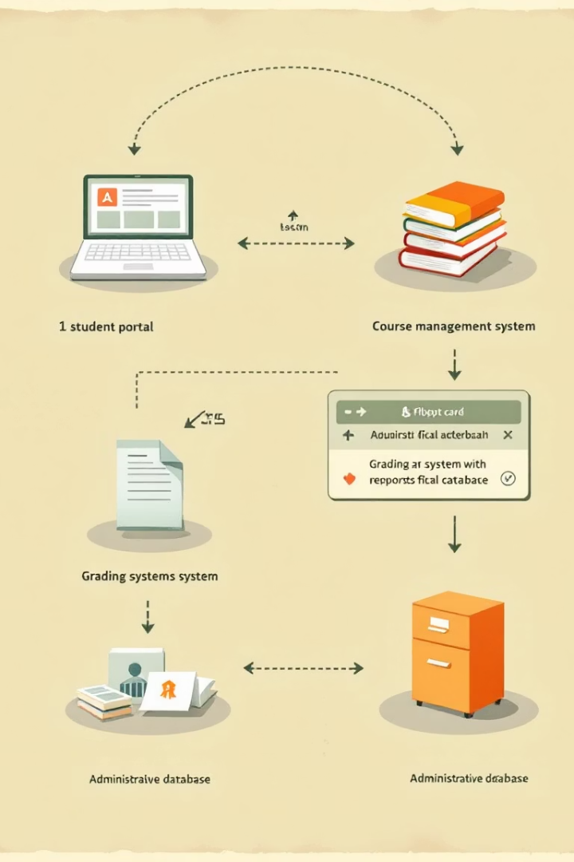
ENTITY RELATIONSHIPS
1
Users
A User can be categorized as a Student, Teacher, Parent, or Admin.
2
students and subjects
A Student is enrolled in multiple Subjects
3
Alerts
Alerts are generated based on student performance and attendance issues.
4
Reports
Reports provide an overview of student progress, generated by an Admin or Teacher.
5
Grades
A Student has multiple Grades, each associated with a specific Subject

Slide 6

ROLE BASED ACCESS AND PRIVILEDGES
Admins
Teachers
•Full control over the system. An Admin user can access all tables in the database
•Manage grades and attendance but cannot modify user information hence maintaining integrity.
Students
Parents
•View their performance reports, grades and attendance reports.
Access student progress by accessing grades and attendance reports and alerts.

Slide 7
BUSINESS RULES IN THE SYSTEM
Student
Alerts
A Student must be enrolled in at least one Subject.
Alerts must be triggered if a student scores below 40%.
Teacher
Attendance Records
Grades
A Teacher must be assigned to at least one Subject.
Attendance records should be updated daily.
Grades must range between 0 and 100.

Slide 8
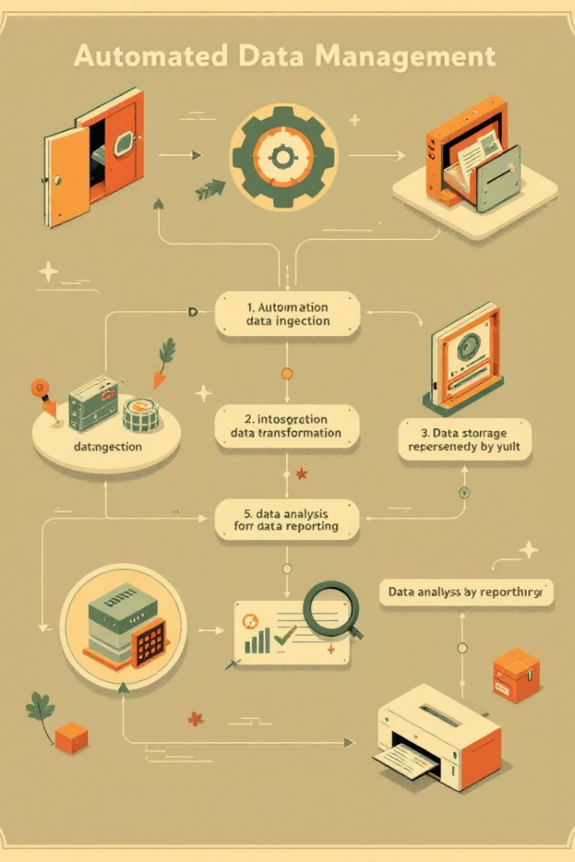



Views & Stored Procedures
Views
Stored Procedures
Views
Predefined queries for performance analysis such as Total_Users-returns total number of users in the system
Automates data management tasks. such as a procedure to retrieve students in a specific class
A data retrieval view that counts alerts based on type.
Stored Procedure
A procedure that retrieves all students in a specific class.
e

Slide 9





Triggers & Constraints
Triggers
Auto-generate alerts for low performance.
Constraints
Ensure valid data (e.g., scores between 0-100 and Email format check which ensures that all emails contain an @ symbol.
Data Integrity
3
Maintains data integrity and reliability.

Slide 10
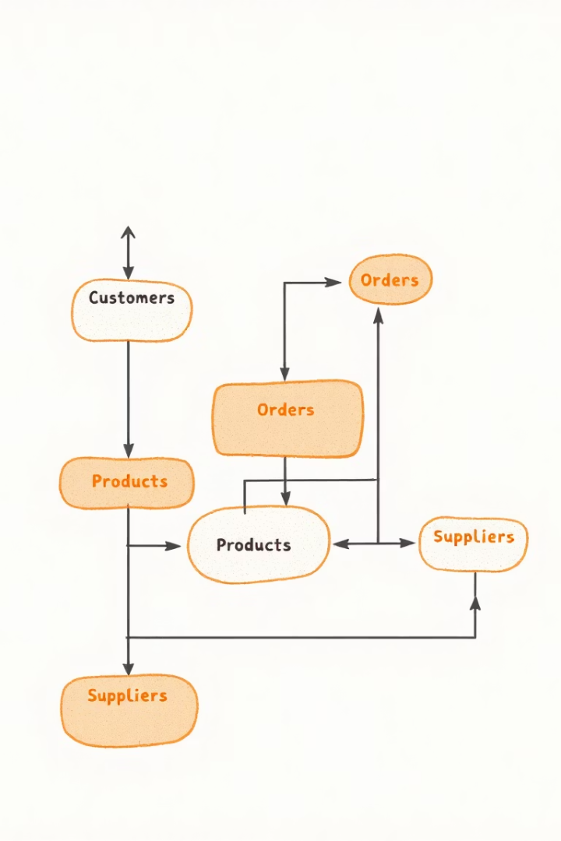
CONCLUSION
•The Smart Academic Performance Monitoring System offers an efficient, user-friendly solution for tracking student progress and managing academic data. By supporting multiple user roles and automating key functions like grading, reporting, and alerts, it enhances communication, accuracy, and accountability. The system empowers stakeholders with real-time insights, promoting transparency and continuous improvement in line with modern educational needs.

